Slide 1
Quality Assurance
Dr. Rachna Patel

Slide 2
7.1 Software Quality
There are many definitions of software quality. In simple words, the software quality means 'how well the software works'. Furthermore we can also state that controlling the variation or differences is the key to high quality software product. Let us see "what is software quality?"
7.1.1 Quality
Software quality can be defined as "the conformance to explicitly stated functional and performance requirements, explicitly documented development standards, and implicit characteristics that are expected of all professionally developed software".

Slide 3
Conti…
There are two kinds of quality
1. Quality of design is the characteristics of the item which is specified for the designer. For example if a temperature control system is designed, then it should display the characteristic of that system is and at the time of design of the product this issue must be focused.
2. Quality of conformance is the degree to which the design specifications are followed during manufacturing. If the degree of conformance is more then it indicates higher quality.
Thus in software development process quality of design is concerned towards requirements, specifications and design of the system and quality of conformance is concerned with implementation.

Slide 4
Conti…
Along with quality of design and quality of conformance. Customer’s satisfaction is very important factor in any software product.
According to Roert Glass and authority in software field.
User satisfaction = Complaint product + good quality +delivery with budget

Slide 5
7.1.2 Quality Control
• Quality control is a process in which activities are conducted in order to maintain the quality of product. These activities are series of inspections, reviews and tests used throughout the software process. These activities ensure whether each work product is satisfying the requirements imposed on it.
• While applying the quality control there should be a feedback loop to the process which generates the work product. With the help of such feedback we can tune the process if it does not satisfy the requirements. The feedback loop helps in minimizing the defects in the software product.
• The quality control activities can be fully automated or it can be completely manual or it can be a combination of automated tools and manual procedures.

Slide 6
7.1.3 Quality Assurance
Definition of quality assurance: It is planned and systematic pattern of activities necessary to provide a high degree of confidence in the quality of a product. It provides quality assessment of the quality control activities and determines the validity of the data or procedures for determining quality.
• The quality assurance consists of set of reporting and auditing functions.
• These functions are useful for assessing and controlling the effectiveness and completeness-of-quality control activities.
• The goal of quality assurance is to ensure the management of data which is important for product quality.

Slide 7
7.1.4 Cost of Quality
The cost of quality can be defined as the total cost required to obtain the quality in the product and to conduct the quality related activities.
The cost of quality has various components such as -
1. Prevention cost - This is the cost of quality required for conducting quality planning, formal technical reviews, test equipment's and training.
2. Appraisal cost - This is the cost of quality required for gaining the insight into the product. It includes the cost required for in-process and inter process inspection, maintenance and testing.
3. Failure cost - Failure cost means the cost required to remove the defects in the software product before delivering it to customer. There are two types of failure costs
4. Internal failure cost - Internal failure is nothing but the cost of defects occurred in the product before delivering it to customer e.g. repair in networking, repairing of communication network.
5. External failure cost - External failure is the cost of defects, occurred in the product after delivering it to the customer e.g. product repair /replace, complaint processing, warranty work.

Slide 8
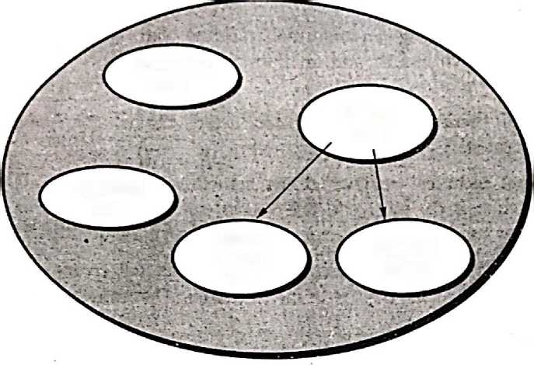
Conti…
Prevention
cost
Failure
cost
Appraisal
cost
Failure cost
Internal
Failure cost
External
failure

Slide 9
7.2 Software Reviews
Software reviews are filter to software engineering process. Such reviews are applied at various points during software development life cycle. The objective of software reviews is to uncover errors and defects that can be removed. The software reviews are conducted for
fallowing reasons -
• Point out needed improvements in the product of a single person or team.
• Confirm those parts of the product in which improvement is not desired.
• Achieve technical work of more uniform quality than can be achieved without
reviews, in order to make technical work more manageable.

Slide 10
Conti…
There are three different ways by which software review can be conducted.
Informal meeting an informal meeting can be conducted outside the working environment and an informal discussion of technical issues can be held.
Formal presentations can be conducted for customer, management and technical staff.
Formal technical reviews(FTR) sometimes as walkthrough or an inspection is the most effective way of software way of software review. This helps a lot for uncovering the software errors and improve the quality of software.
Benefit of formal technical reviews or walkthrough is that error can be discovered in early stage before they become defects in the next release of software.

Slide 11
7.2.1 Defect Amplification Model
A defect amplification model can be used to illustrate the generation and detection of errors during the steps in the software engineering process.
This model is as given below -
Development step
Defects
Detection
Errors passed through
Percent efficiency for error detection
Errors from previous steps
Amplified errors 1:x
Errors passed to next step
Newly identified errors

Slide 12
Conti…
In the defect amplification model the outer box indicates the software development stage. This box is partitioned into two categories, defects and detection of The error. Under the defect column we list out number of errors. Errors can be those coming from previous stage or it could be newly generated errors.
The previous errors can be those that are passed through errors as well as the amplified errors. The error amplification factor is denoted by x.

Slide 13
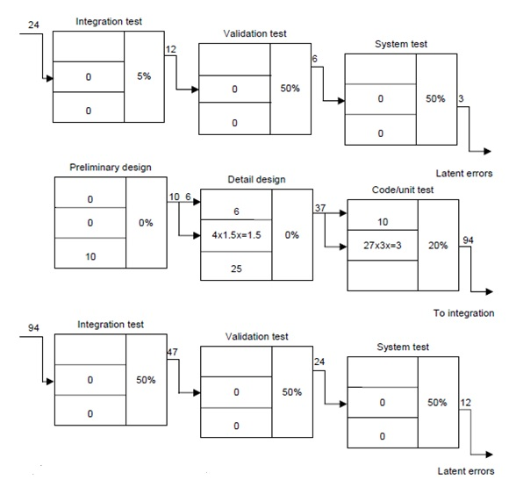

Slide 14
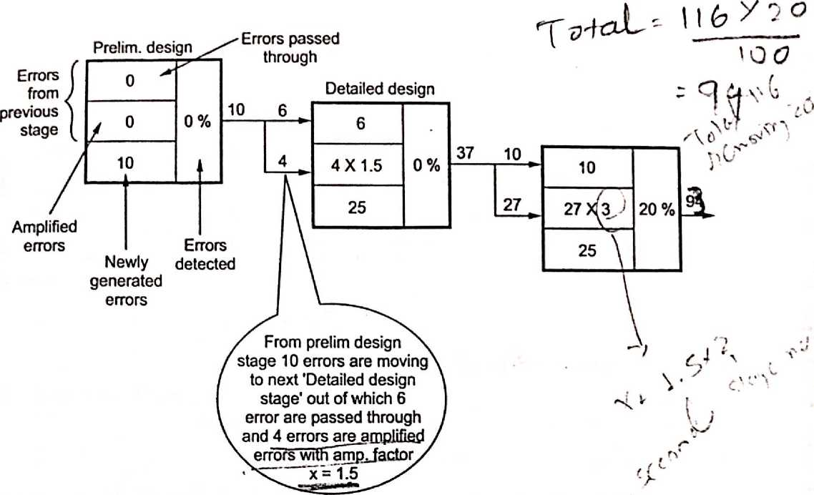
Conti…

Slide 15
7.3 Software Quality Assurance
The quality is the conformance to functional and non functional requirements of the product
There are three main reasons for why software quality sets failed?
1. Software requirements must be well understood before the software development process begins.
2. Similar to explicit requirements it is also essential to understand the implicit requirements of the software. If the software confirms the explicit requirements. but not satisfying the implicit requirements, then surely quality of software being developed is poor.
3. The set of development criteria has to be decided in order to specify the standards of the product. This will ultimately help the software engineer during development If such a criteria is not been fixed then definitely the software product will lack the quality. Software quality assurance is the process m which conformance to the requirements of the product is made.
This represents the importance of SQA.

Slide 16
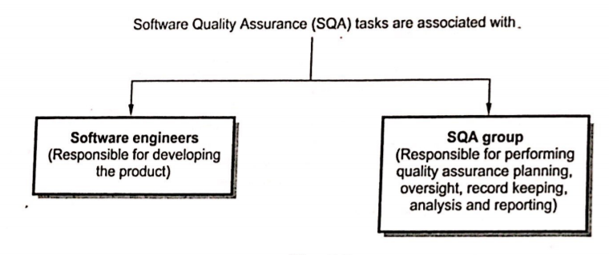
7.3.1 Software Quality Assurance (SQA) Activities
Let us list out the SQA activities conducted by SQA group

Slide 17
Conti…
1. Prepare an SQA plan for a project.
A SQA plan is developed while planning the project quality assurance activities are conducted that are indicated in this plan. This plan basically
• Identifies evaluations to be performed.
• Audits and reviews to be performed, standards that should be adopted for the
project.
• Procedures for error reporting and tracking.
• It also specifies documents to be produced by SQA group.
• Amount of feedback provided to the software project team.

Slide 18
Conti…
2. Participates in the development of the project's software process description.
The process selected by the software team is reviewed by the SQA group. This review is for
• Process description to ensure that it follows the organizational policy.
• Internal software standards.
• Some standards that are adopted by the organization.
3. Reviews software engineering activities to verify compliance with the defined software process
The SQA group identifies and documents the processes. The group also verifies the correctness of software process.

Slide 19
Conti..
4. Audits designated software work products to verify compliance with those defined as part of the software process.
The SQA group performs following tasks -
• Reviews selected work product
• Identifies the process
• Documents them
• Tracks deviations
• Verifies the correctness made in the processes
• Regular reporting of results of its work to the project manager.

Slide 20
Conti…
5. Ensure the deviations in software work. These work products are documented and handled according to documented procedure.
The deviations in software work are identified from project plan. These processes are identified and handled according to documented procedure.
6. Records any noncompliance and reports to senior management
Non compliance items are identified and pursued until they get resolved. The periodic reporting about it is done to project manager.

Slide 21
7.4 Statistical Software Quality Assurance
Statistical software quality assurance is a simple concept which represents that changes in the software can be made in order to improve those elements of the process that introduce error. Statistical software quality assurance can be performed with the help of
following steps -
1. Collect the information about software defects. Categorize them
2. Make an attempt to trace each defect to its root cause
3. Isolate the vital few causes of the major source of all errors by using the 80-20 principle(known as Pareto principle). This principle is "80 % of the defects can be traced to 20% of all possible causes".
4. Then move to correct the problems that have caused the defects.
Example
Consider that a well known software firm has collected some information about the defects that are occurring in the software product.

Slide 22
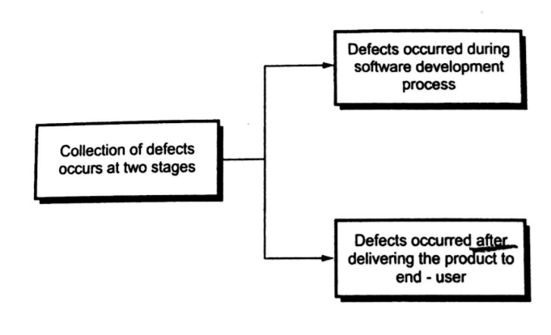
Conti…

Slide 23
Conti…
The causes of defects are tabularized as below
Causes of defects | Abbreviations
Error in data representation | EDR
Error in design logic | EDL
Unclear human computer interface | HCI
Incomplete and/or erroneous specifications | IES
Intentional deviations from specifications | IDS
Inconsistent component interface | ICI
Incomplete and/or erroneous testing | IET
Incomplete or inaccurate documentation | IID
Error in programming language translation of design | PLT
Violation of programming standards | VPS
Misinterpretation of customer communication | MCC
Miscellaneous | MIS

Slide 24
Conti…
Causes of defect | Number of errors | Percentage
IES | 200 | 21
MCC | 158 | 17
IDS | 48 | 5
VPS | 20 | 2
EDR | 128 | 14
ICI | 60 | 6
EDL | 45 | 5
IET | 94 | 10
IID | 35 | 4
PLT | 60 | 6
HCI | 30 | 3
MIS | 58 | 6
TOTAL | 936 | 100 %
Suppose that some sample representative data of defect causes is collected then one on build a statistical SQA from it. The sample data about the defect cause is as given below.

Slide 25
Conti…
From above table it is clear that the major defect cause is IES+MCC+EDR which generates 21+17+14 = 52 % of total errors. We can say that these errors are few vital errors that cause the major defect in the software product. Once such vital causes are determined then it becomes very easy for a software engineer to take corrective action. For instance in the vital few cause given above.
• The cause IES (incomplete erroneous specification )can be improved by having proper communication with the customer.
• One cause is MCC (i.e. Misinterpretation of customer communication). If the customer communication is improved then this vital cause of defect can be removed.
• Similarly to improve EDR (i.e. error in data representation) some CASE tools can be used to remove this defect.
• Thus if IES+MCC+EDR i.e. 52 % of defect cause is removed. This will ultimately help in improving the software quality.

Slide 26
7.5 Approaches to SQA
• The software quality should be obtained during the analysis, design, coding and Testing. It should be obtained using formal technical reviews and by performing multi-tier testing strategies.
• A small segment of software engineering community demands that a formal approach to software quality assurance is required. They demand that a rigorous approach is required for requirement gathering and its specification.
• If such rigorous approach is adopted for requirement specification then software can be correctly built as per its specification.
• The efforts are made to adopt the formal approach of development for structured programming concepts.

Slide 27
7.6 Software Reliability
Software reliability is defined as the probability of failure free, operation of a computer program in specified environment for specified time.
The software reliability can be measured, directed and estimated.

Slide 28
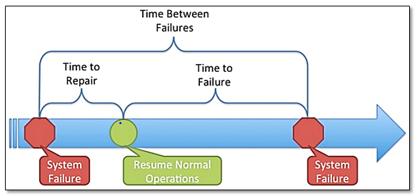
7.6.1 Measure of reliability and availability
Normally there are two measures of software reliability.
1. MTBF mean time between failure is a simple measure of software reliability which can be calculated as
MTBF= MTTF + MTTR
Where MTTF means mean time to failure
And MTTR stands for mean time to repair.
Many software researchers feel that MTBF is more
useful measure of software reliability then
defects/KLOC or defect/FP.

Slide 29
Conti…
2. Availability
It's another measure of software reliability, software availability is defined as the
probability that the program is working according to the requirements at a given
points in time. It is measured as
Availability = (MTTF/(MTTF+MTTR))* 100 %
MTBF is equally sensitive to MTTF and MTTR but availability is more sensitive to
MTTR.

Slide 30
7.6.2 Software Safety
Software safety is a quality assurance activity in which potential hazards are identified and assessed. These hazards may bring the total failure of the system. If such hazards are identified and specified in early stage of software development then such hazards can be eliminated or controlled in order to make the software safe. Modeling and analysis process is conducted as a part of software safety.
For example : In a computer based automobile system software hazards are
1. Uncontrolled acceleration that can not be stopped.
2. Does not respond to slow the system when breaks are applied.
3. Slowly gains the speed.

Slide 31
Conti…
How to handle the system level hazards(danger or risk)?
Following are the steps that can be applied to preserve the software safety.
Step 1 : The hazards are identified.
Step 2 : Analysis techniques are used to assign severity of these hazards. The probability of occurrence of such hazards is also analyzed with fop help of analysis techniques. The commonly used analysis techniques are fault-tree "analysis, real-time logic and Petri-net models. These techniques basically predict the chain of event that can cause hazards.
Step 3 : Once hazards are identified, safety related requirements can be specified for the software. This specification basically includes list of undesirable events and desired system response. The template for safety related requirement“
specification is given below -

Slide 32
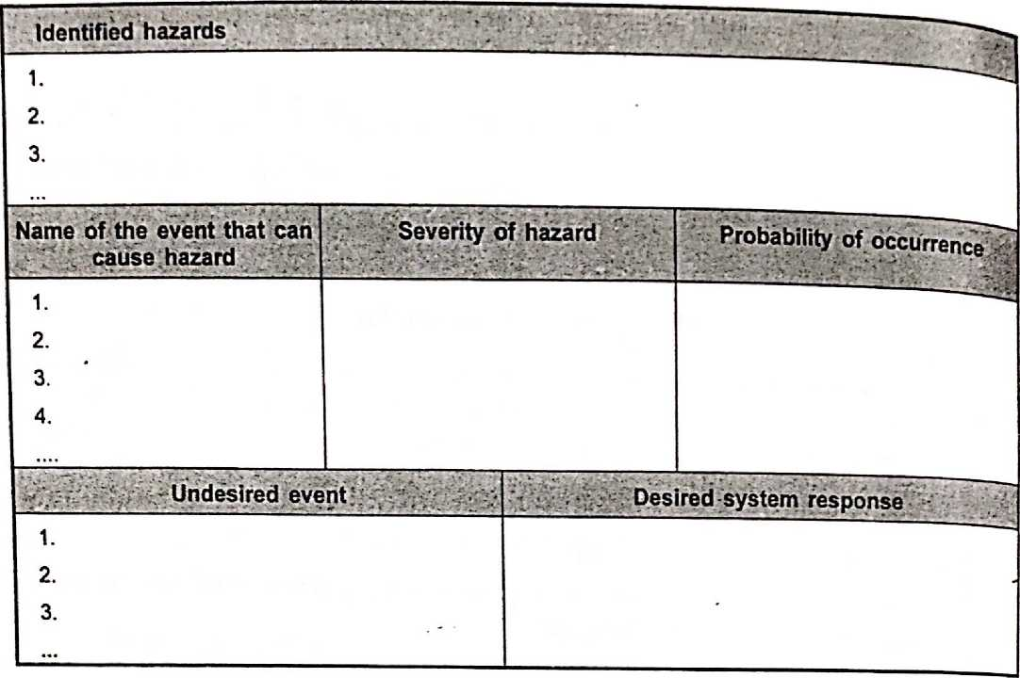
Conti…

Slide 33
Conti…
What is the difference between software reliability and software safety?
• Software reliability and software safety are closely related to each other. However, the difference between them lies in degree and not the type.
• Software reliability uses statistical analysis made to determine the occurrence of software failure. These failures will cause simply dissatisfaction of customer requirements. But the software safety examines the ways in which failure results in conditions that can lead to hazards.
• Software reliability does not detect the failures in depth. But the software safety detects the failures in context of an entire computer based system.

Slide 34
7.7 Software Quality Standards- ISO 9000 and 9001
In order to bring quality in the product-and service, many organizations are adopting the quality assurance system. The quality assurance systems are the organizational structures that are used to bring quality in responsibilities, procedures, processes and resources .
ISO 9000 is a family of quality assurance system. It can be applied to all type of organizations. It doesn't matter what size they are or what they do. It can help both product and service oriented organizations to achieve standards of quality. ISO 90001 is maintained by ISO, the International Organization for standardization and is administered by accreditation and certification bodies. In ISO 9000, company's quality system and operations are scrutinized by third-party auditors for a compliance to the standard and effective operation. This process is called registration to ISO 9000. On successful registration, the company gets a certification from accreditation bodies of ISO. Such a company is then called "ISO certified company".

Slide 35
Conti…
ISO 9001:2000 is a quality assurance standard which is applied to software engineering System. it focuses on process flows, customer satisfaction, and the continual improvement Of quality management system. ISO 9001:2000 specifies requirements for a quality system that can be applied to any size or type of organization. The guideline steps for ISO 9001:2000 are

Slide 36
Conti…
Establish quality management system - Identify and manage the processes in the quality management system.
Document the quality management system
Support the quality
Satisfy the customers
Establish quality policy
Conduct quality planning
Control quality systems
Perform management reviews
Provide quality resources
Provide quality personnel
Provide quality infrastructure
Provide quality environment
Control realization planning
Control customer processes
Control product development
Control purchasing functions
Control operational activities
Control monitoring devices
Control non confirming products
Analyze quality information
Make quality improvement

Slide 37
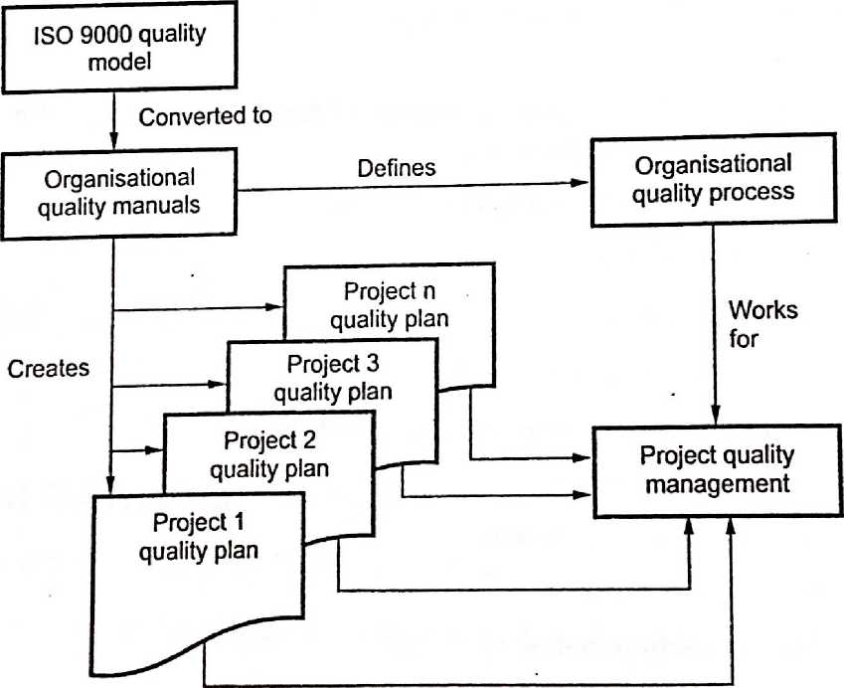
Conti…
The ISO 9000 helps in creating organizational quality manuals. These quality manuals identify the organizational quality processes. Using these quality manuals the project quality plan can be prepared for every individual project. Thus project quality management can be done.

